Slide 1

Cyber Ethics
Presented By
E.Balaji
Computer Science And Engineering
The Kavery Engineering College

Slide 2
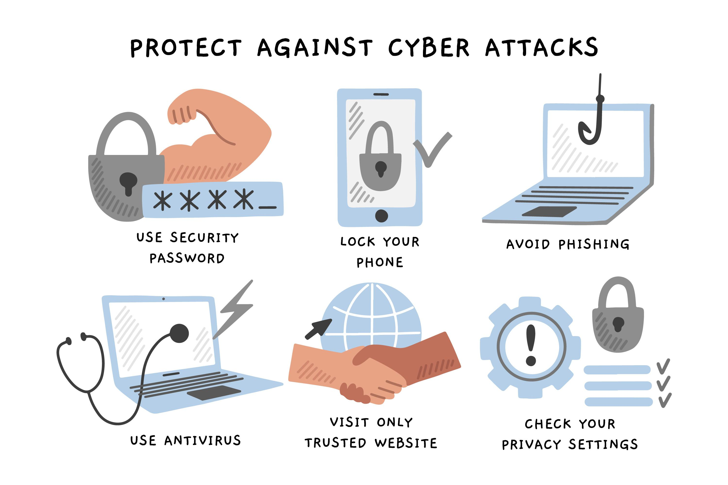
Introduction to Cyber Ethics
In our rapidly evolving digital landscape, the field of cyber ethics has become increasingly crucial. Cyber ethics examines the moral and social implications of the technologies that shape our lives, from the internet and social media to artificial intelligence and cybersecurity. As our reliance on technology deepens, it is vital that we develop a robust ethical framework to guide the development and use of these powerful tools.

Slide 3
Problem Statement
1
Privacy Concerns
2
Cybersecurity Threats
The ubiquity of data collection and sharing online raises critical questions about personal privacy and the ethical use of this information.
Cyber attacks, data breaches, and other malicious activities pose significant risks to individuals, organizations, and society as a whole, necessitating robust ethical considerations.
3
Algorithmic Bias
4
Digital Divide
The algorithms that power many digital systems can perpetuate and amplify societal biases, with far-reaching consequences that must be addressed.
The uneven access to technology and digital resources can exacerbate existing inequalities, creating ethical challenges around digital inclusion and equity.

Slide 4
Proposed System/Solution
Ethical Frameworks
User-Centric Design
Collaborative Governance
Developing comprehensive ethical frameworks to guide the design, development, and deployment of digital technologies, ensuring they align with fundamental human values and principles.
Prioritizing user privacy, security, and well-being in the design of digital systems, empowering individuals to make informed choices about their personal data and online activities.
Fostering collaboration between policymakers, technology companies, and civil society to establish clear ethical guidelines and accountability measures for the digital landscape.

Slide 5

System Development Approach
1
Stakeholder Engagement
Engage a diverse range of stakeholders, including end-users, industry experts, ethicists, and policymakers, to gather insights and ensure the proposed system addresses their needs and concerns.
2
Ethical Risk Assessment
Conduct a thorough ethical risk assessment to identify potential ethical pitfalls and vulnerabilities in the system, allowing for proactive mitigation strategies.
3
Iterative Development
Adopt an iterative development approach, regularly evaluating the ethical implications of the system and making necessary adjustments to align with evolving ethical standards and best practices.

Slide 6
Algorithm and Deployment
Algorithmic Transparency
Ethical Deployment
Ensure the algorithms powering the system are transparent and accountable, with clear explanations of their decision-making processes to mitigate bias and build user trust.
Develop and implement ethical deployment strategies that prioritize the wellbeing of users, protect their privacy, and minimize the potential for harm or misuse of the system.
Ongoing Monitoring
Ethical Governance
Establish a robust monitoring and evaluation framework to continuously assess the ethical impact of the system, allowing for timely adjustments and improvements.
Implement ethical governance structures to provide oversight, decision-making, and accountability for the system, ensuring it remains aligned with the established ethical principles.

Slide 7
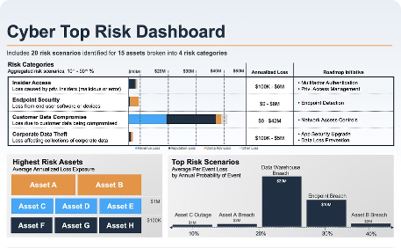


Result (Output Image)
Ethical Dashboard
User Privacy Protection
Ethical Training
The proposed system includes an ethical dashboard that provides real-time monitoring of key ethical indicators, enabling stakeholders to assess the system's performance and make informed decisions.
The system includes comprehensive training modules for users, developers, and stakeholders, fostering a shared understanding of cyber ethics and promoting responsible technology use.
The system incorporates robust privacy protection measures, empowering users to control their personal data and ensuring their information is securely stored and ethically leveraged.

Slide 8
Conclusion
In the rapidly evolving digital landscape, the field of cyber ethics has become increasingly crucial. By developing comprehensive ethical frameworks, prioritizing user-centric design, and fostering collaborative governance, we can ensure that digital technologies align with fundamental human values and principles. The proposed system, with its emphasis on algorithmic transparency, ethical deployment, and ongoing monitoring, represents a significant step towards a more ethical and responsible digital future. As we continue to push the boundaries of technological innovation, it is our collective responsibility to uphold the highest ethical standards and safeguard the wellbeing of individuals and society as a whole.

Slide 9




Future Scope
Emerging Technologies
As new technologies, such as artificial intelligence, quantum computing, and the Internet of Things, continue to emerge, it will be essential to proactively address their ethical implications and ensure they are developed and deployed responsibly.
Global Collaboration
Fostering international collaboration and the development of global ethical standards for digital technologies will be crucial in creating a more equitable and inclusive digital future.
Ethical Education
Integrating cyber ethics education into academic curricula and professional training programs will help cultivate a new generation of ethically-minded technology innovators and users.

Slide 10

Reference
Brey, P. (2012). Anticipatory ethics for emerging technologies. Nanoethics, 6(1), 1-13.
Floridi, L. (2018). Soft ethics and the governance of the digital. Philosophy & Technology, 31(1), 1-8.
Mittelstadt, B. D., Allo, P., Taddeo, M., Wachter, S., & Floridi, L. (2016). The ethics of algorithms: Mapping the debate. Big Data & Society, 3(2), 2053951716679679.

